Slide 1
Water World
Adrien Chabert
1

Slide 2





Bachelor Project - UNIGE
1

Slide 3


200’000 km³ of fresh water
1
Notes:
200’000 km3 of fresh water on earth
2/3 for irrigation
Decrease water consumption of 20%-25%
1

Slide 4
Research of Literature
Collect Data
Integration of Machine Learning Algorithm
Test our result
Create a watering program
1

Slide 5
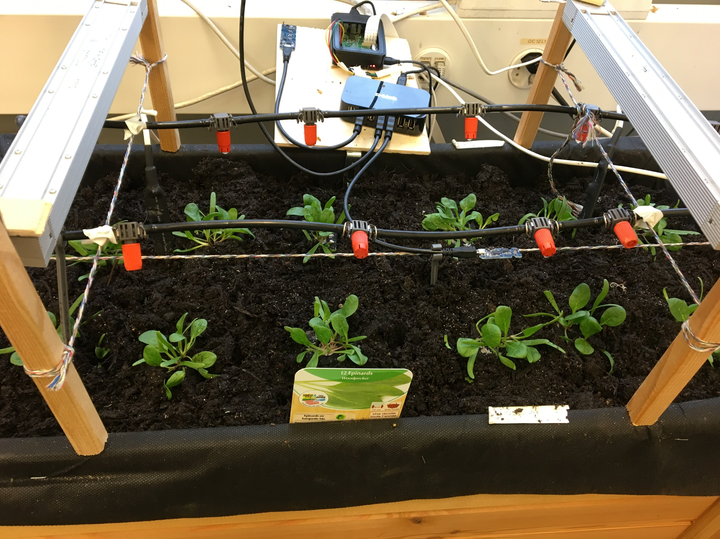
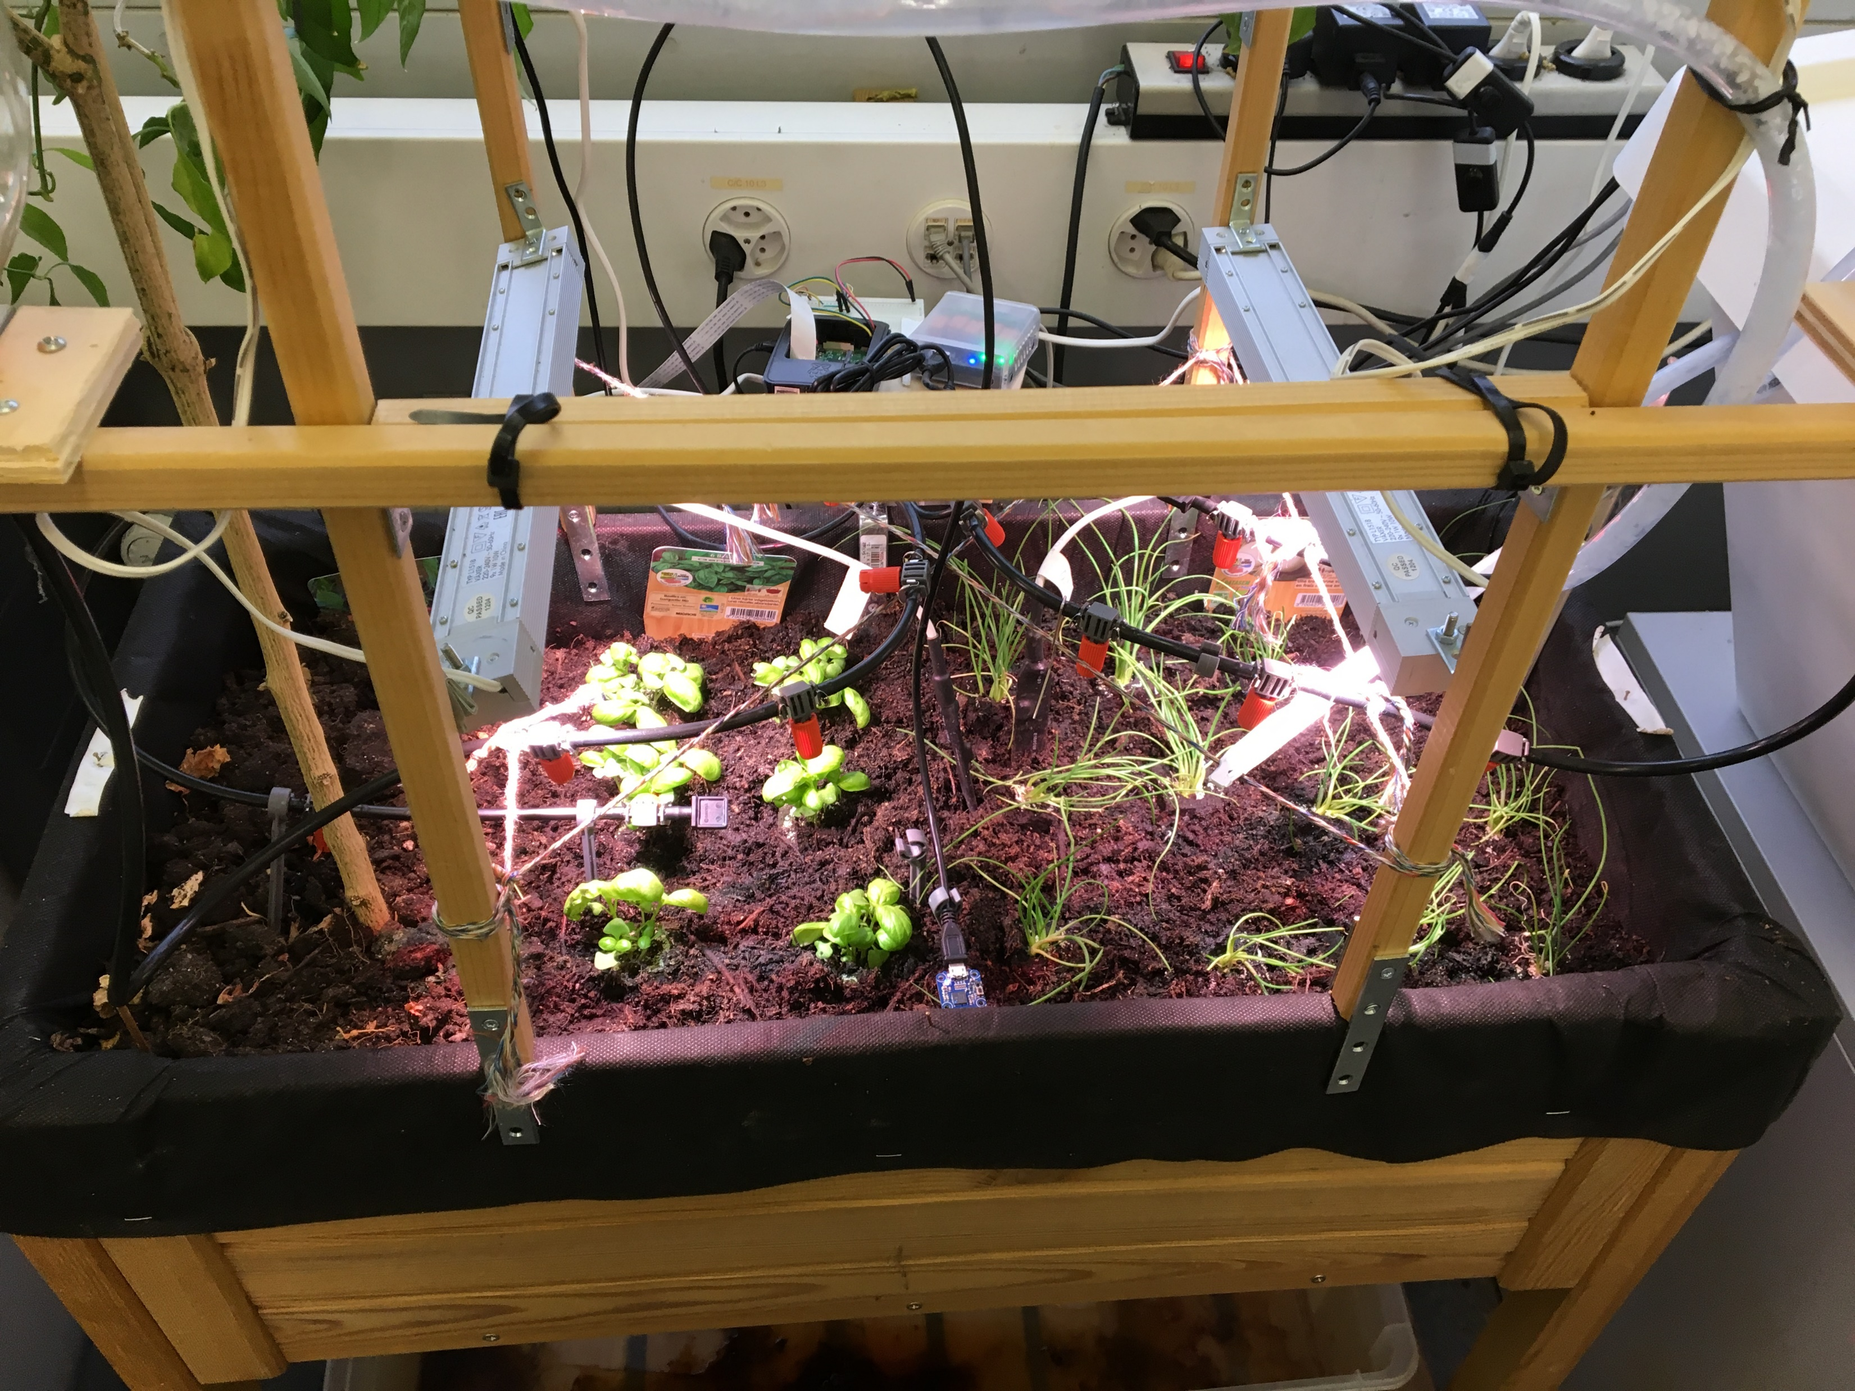
Planting
Basilic, onion, spinach
1

Slide 6
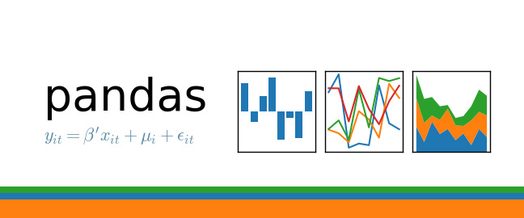



1

Slide 7
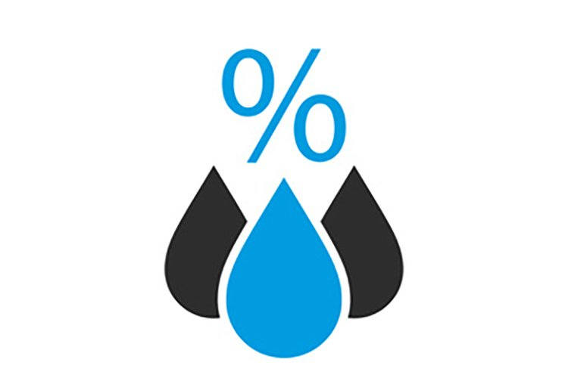



1
Notes:
Le vent impacte également mais pas dans notre cas
1

Slide 8
What I did with my data
Reading data in dataframe
Add information on my dataframe
Eliminate NaN value
Implement some different strategy
Analyse result
1
Notes:
J’ai pas ajouté l’information sur la croissance de la plante.
1

Slide 9
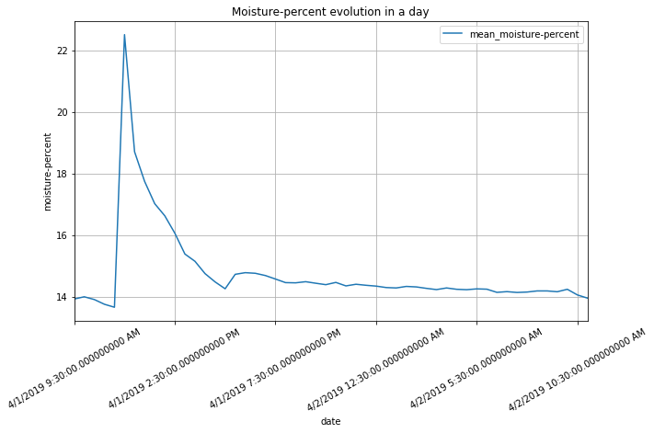
1
Notes:
1

Slide 10
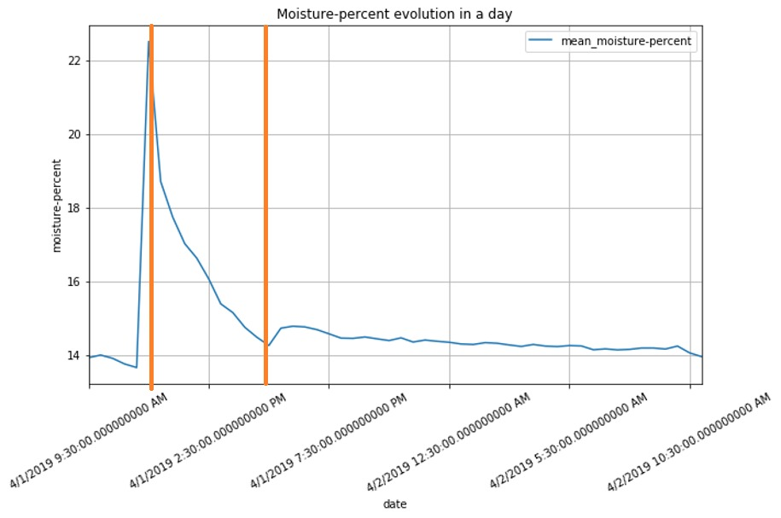
Value ?
1
Notes:
1

Slide 11
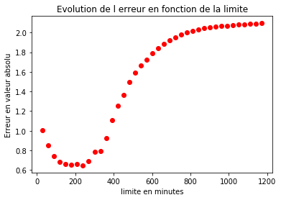
1
Notes:
1

Slide 12
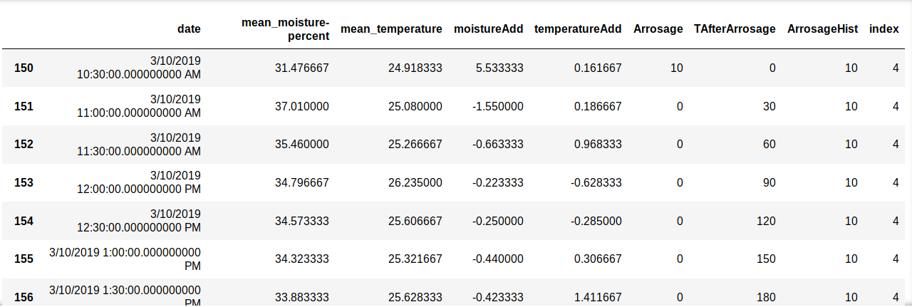
1

Slide 13
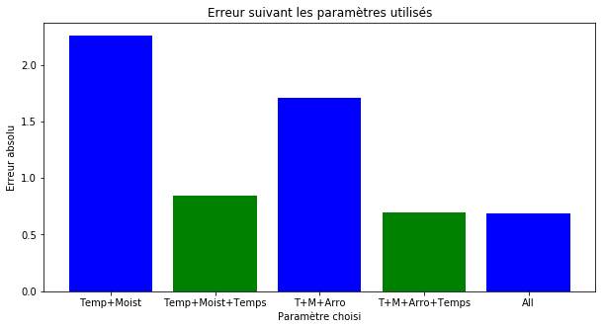
1
Notes:
1

Slide 14
Moisture
Watering
Temperature
Time after watering
Day
Moisture
Watering
Day
270 minutes
Moisture
Watering
Temperature
Time after watering
Day
1
Notes:
1

Slide 15
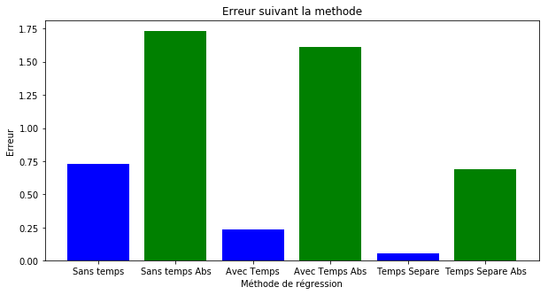
Sans le temps : -0.72907607234
Sans le temps absolue : 1.72805282656
Avec le temps : -0.237446447338
Avec le temps absolu : 1.61026013894
Avec Temps Séparé : -0.0575398672782
Avec Temps Séparé absolu : 0.690294389607
1
Notes:
<numéro>

Slide 16
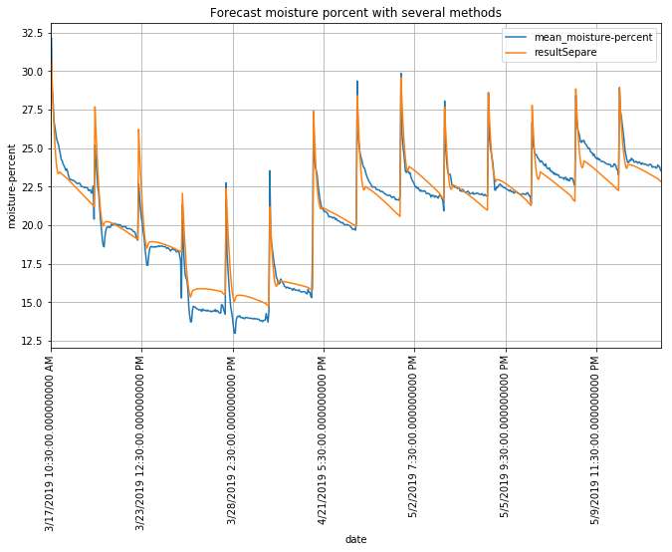
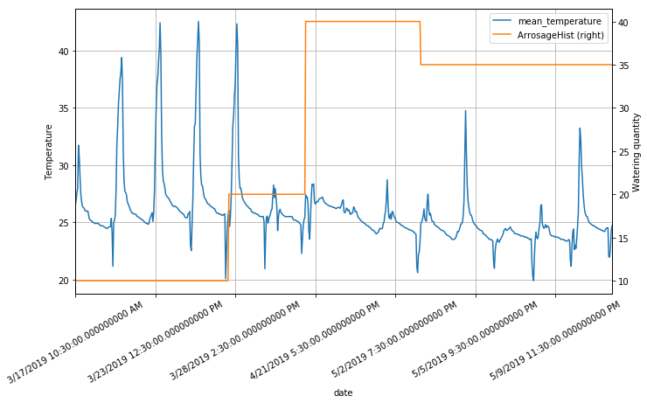
1
Notes:
<numéro>

Slide 17
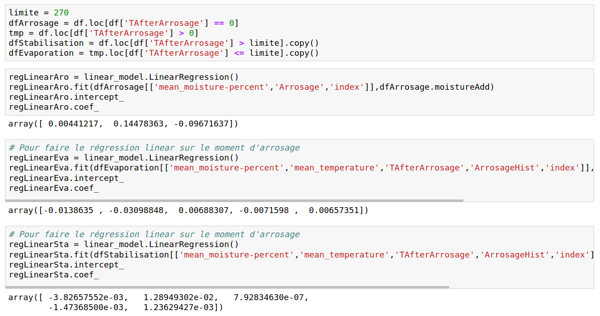
1
Notes:
<numéro>

Slide 18
Date | Demeter | Ceres
6-Mar | 10 s/j | 10 s/j
13-Mar | 10 s/j | 10 s/j
20-Mar | 10 s/j | 10 s/j
27-Mar | 20 s/j | 15 s/j
3-Apr | 20 s/j | 15 s/j
10-Apr | 20 s/j | 15 s/j
17-Apr | 40 s/j | 30 s/j
24-Apr | 40 s/j | 30 s/j
1-May | 40 s/j | 30 s/j
3-May | 35s/j | 20 s/j
9-May | 35s/j | 20 s/j
16-May | 35s/j | 20s/j
23-May | 45s/j | 10s/j
30-May
Watering Plan
1
Notes:
<numéro>

Slide 19
Planning for the next 3 weeks
To move on with my final written report
To find a solution for temperature and high moisture
To create a watering programme
Have a better presentation
Be more flexible
1
Notes:
Ou Bayesian learning machine approach for Regression
<numéro>

Slide 20
Project Planning
1

